Slide 1
Data55:
Richard, Anneke, Brendan,
Sara, Brenton, Saini and Aditya

Slide 2
Overview - Framework
AngularJS client side applications
Means one consistent language between client and server side
Node.js server side handling
Allows for easier manipulation of HTTP requests
Allows for development of a RESTful Web service
PostgreSQL (Postgres) database
Very similar to mySQL
Known for compatibility with angular and node

Slide 3
Overview - Stories assigned to Sprint
Student - Registration
Teacher - Registration
Student - Apply for Lessons
Teacher - Accept Student
Student - Get General Lesson Information
Manager - Add New Instruments
Student - Hire Instrument
Manager - Mark Instruments Returned
Manager - View Instrument Hire Requests

Slide 4
Overview - Stories Status
Untouched | In Progress/Almost Finished | Finished/Testing
 |  | Student Registration
 |  | Teacher Registration
 | Student Lesson Application
 | Accept Student
 | Lesson Information Page
 |  | Add New Instruments
 | Student Hire Instrument
Manager Inst. Hire requests
Student Specific Teacher

Slide 5
Overview - Time Management & Issues encountered
New tools and languages
No login user story
Not everyone understands the system architecture yet
Not everyone is familiar with GitHub
Misunderstandings of user story (Get Lesson Info)
These issues resulted in additional time being spent on all tasks, as well as existing user stories needing to be delayed for more important ones.

Slide 6
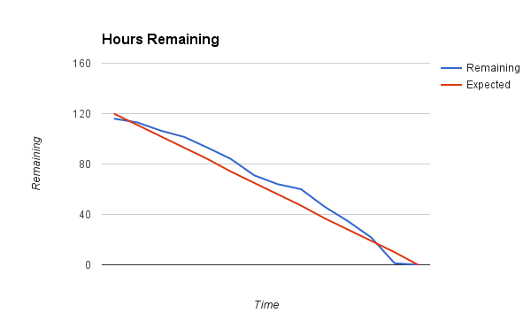
Overview - Hour Burndown Chart

Slide 7
Stories: Student Registration (AALV-60)
Done:
Created Database Tables and Queries
Created Frontend Page
Added Validation
Created Service to manage registration
To do:
Email services
Test to ensure no errors or bugs
Merge Template with Application
Acceptance Criteria:
Create account
Enter personal details (name, dob, address)
Able to successfully register
Email validation

Slide 8
Stories: Teacher Registration (AALV-27)
Done:
Created Database Tables and Queries
Created Frontend Page
Added Validation
Created Service to manage registration
To do:
Email services
Test to ensure no errors or bugs
Merge Template with Application
Acceptance Criteria:
Able to enter general details - Name, email, phone, address
Able to create account if details are given produces error if not
Email account details to teacher with temp password that needs to be changed on first login
Teacher account can log in after creation
Teacher prompted to change password on login

Slide 9
Stories: Student Lesson Application (AALV-11)
Done:
Created Database Tables and Queries
Created Frontend Page
Added Validation
Created Service to manage registration
To do:
Style Confirmation Page
Email services
Test to ensure no errors or bugs
Merge Template with Application

Slide 10
Stories: Teacher Accept Student (AALV-61)
Done:
Created Database Tables and Queries
Created Frontend Page
To do:
Add Validation
Create Service
Test to ensure no errors or bugs
Merge Template with Application

Slide 11
Stories: Student Get Lesson Info (AALV-58)
Done:
Created Frontend Page
Wrote Content
To do:
Style Page

Slide 12
Stories: Add New Instruments (AALV-37)
Done:
Created Database Tables
Created Frontend Page
Add Validation
Create Service
To do:
Testing

Slide 13
Stories: Hire Instruments (AALV-14)
Done:
Created Database Tables
Created Frontend Page
Created Slot in lesson application
To do:
Create Service
Testing

Slide 14
Stories: Return Instruments (AALV-35)
Done:
Created Database Tables
To do:
Create Page
Create Service
Testing

Slide 15
Stories: View Hire Requests (AALV-32)
Done:
Created Database Tables
Create Page
To do:
Create Service
Testing

Slide 16
Stories: Request Specific Teacher (AALV-12)
Done:
Created Database Tables
Create Page
To do:
Create Service
Testing

